Slide 1
Rating Prediction
Submitted by
Tushar Kumar Patel

Slide 2
Project analysis slide 2
Project Analysis
Inrtoduction
Visualization
Rating Prediction
Dataset and Features
Model
Processing
Conclusion

Slide 3
Introduction
Website where people write different reviews for technical products. Now they are adding a new feature to their website i.e. The reviewer will have to add stars(rating) as well with the review. The rating is out 5 stars and it only has 5 options available 1 star, 2 stars, 3 stars, 4 stars, 5 stars. Now they want to predict ratings for the reviews which were written in the past and they don’t have a rating. So, we have to build an application which can predict the rating by seeing the review.
Initially the collection of the data of flight ticket price has been scrapped using selenium.

Slide 4
CONCEPTUAL BACKGROUND OF THE DOMAIN PROBLEM
E-commerce companies offers various products the list is very long so we have decided to do rating prediction from the available reviews present in the e-commerce websites. To do that first we have to scrap the data from the websites. We need to convert the reviews into lower case, then we have to clean the data in which there are many unnecessary things which are no needed while analysis like unwanted spaces, unnecessary use of words, use of short words that they used to communicate in their daily life that is not required for the analysis prediction.

Slide 5
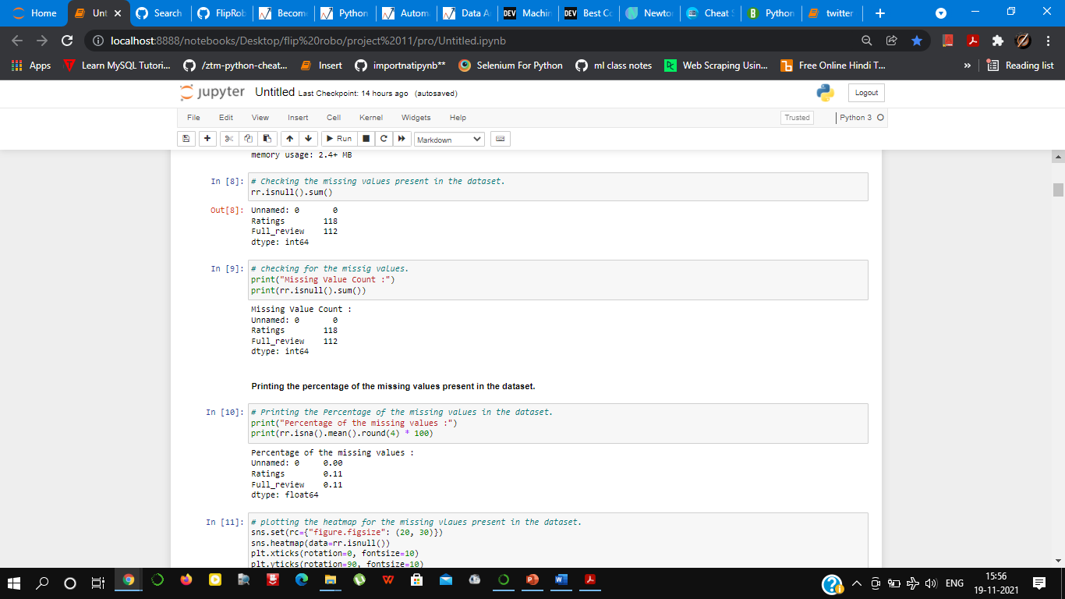
Data Set Description
Features:
Rating: Rating provided by the customer.
Full_review: Detailed written review provided by the customers.
The dataset has many null values.
In rating there are 118 missing values.
In Full_review there are 112 missing values.

Slide 6
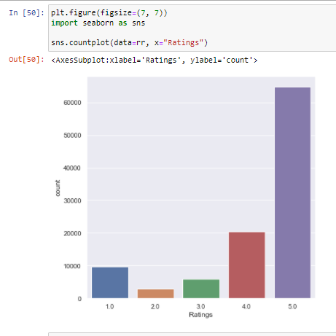
Visualization
Plot of rating provided by the customers

Slide 7
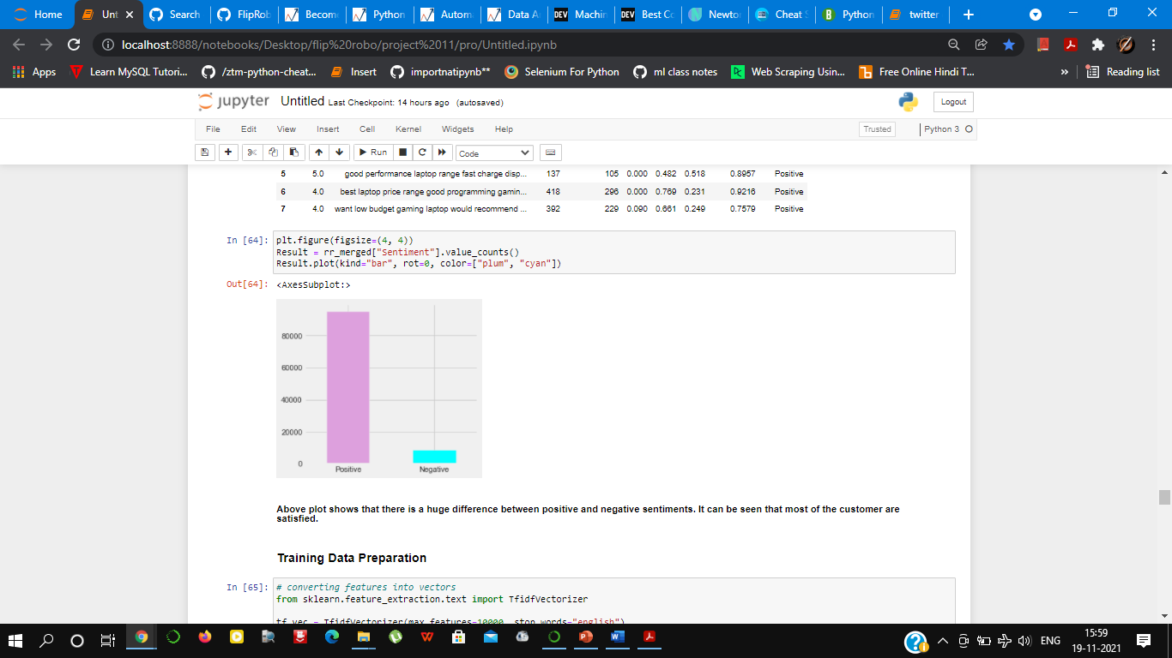
Sentiments of the customers
In this this will tell about the sentiment of the customers, whether they are satisfied or not.
From this plot it can be seen
that the customers are satisfied
with their purchase.

Slide 8
Data Processing.
In this data there are missing values.
To check the missing values we use
the command.

Slide 9
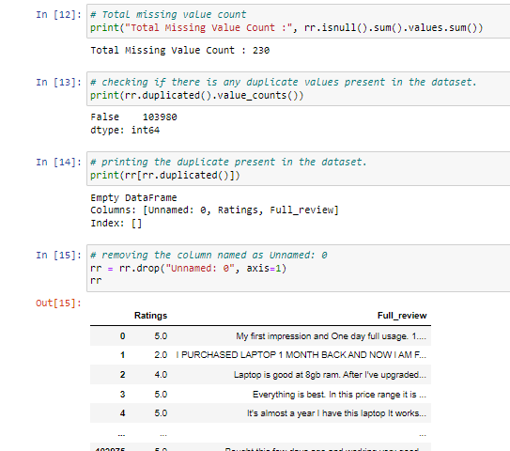

Slide 10
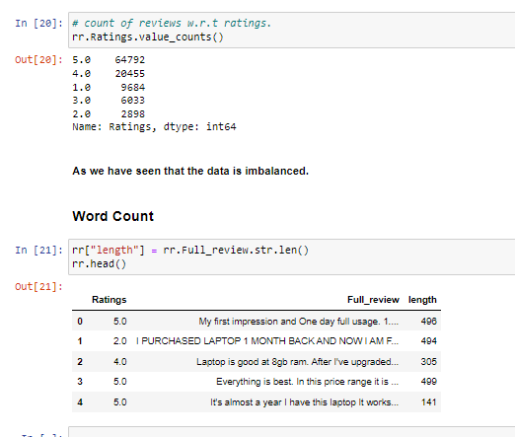

Slide 11
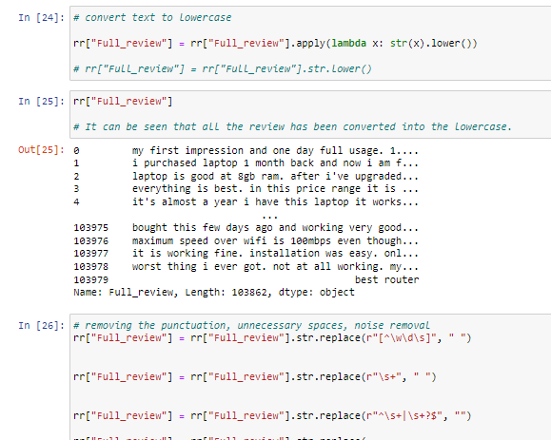

Slide 12
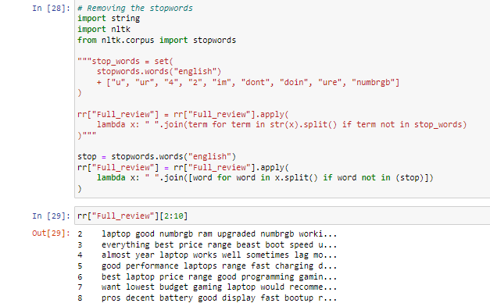

Slide 13
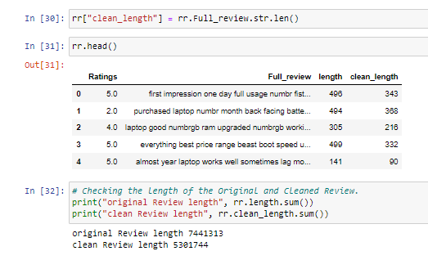

Slide 14
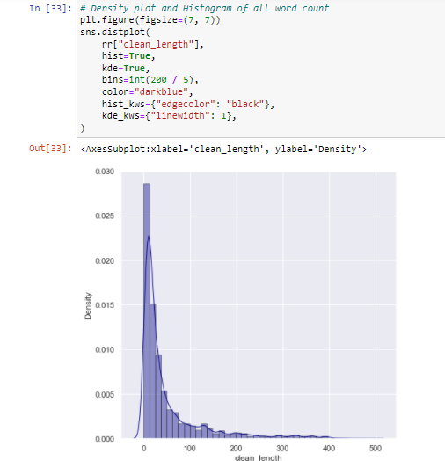

Slide 15
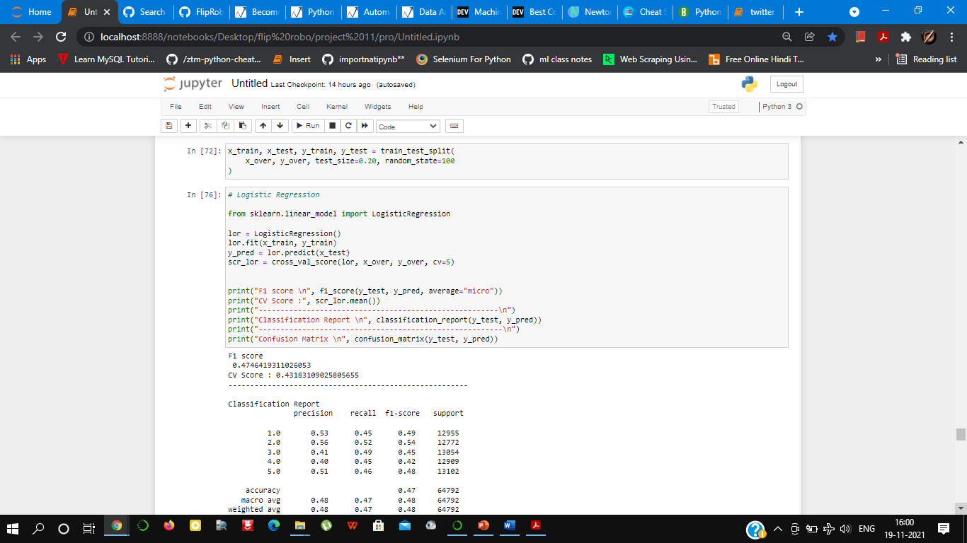
Model Building

Slide 16
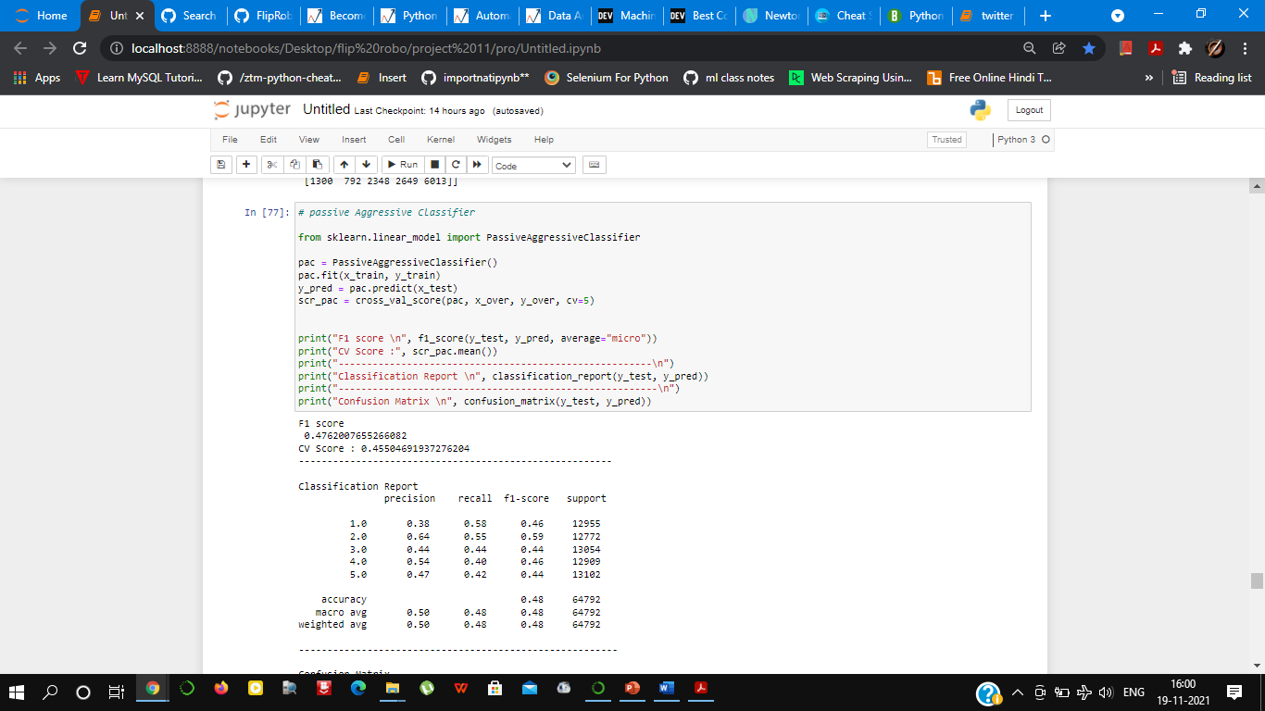

Slide 17
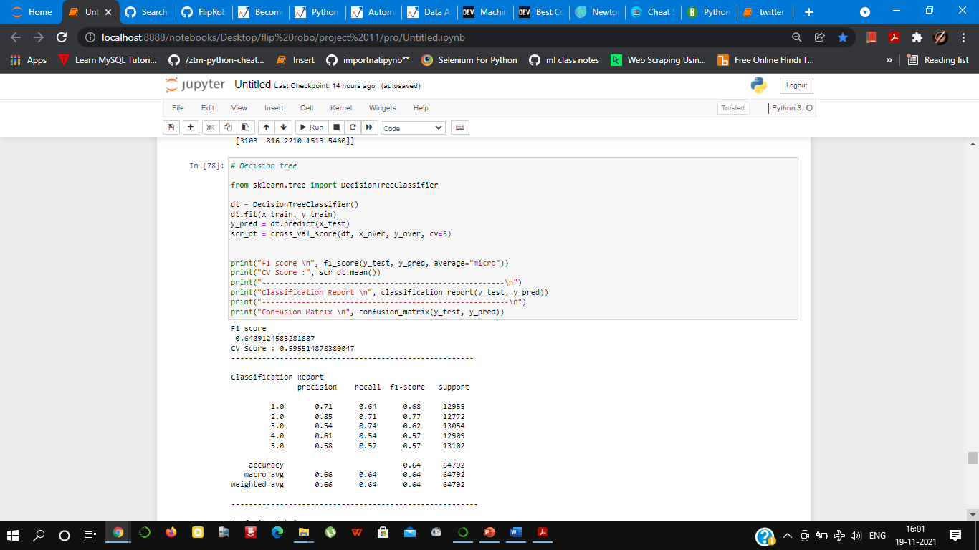

Slide 18
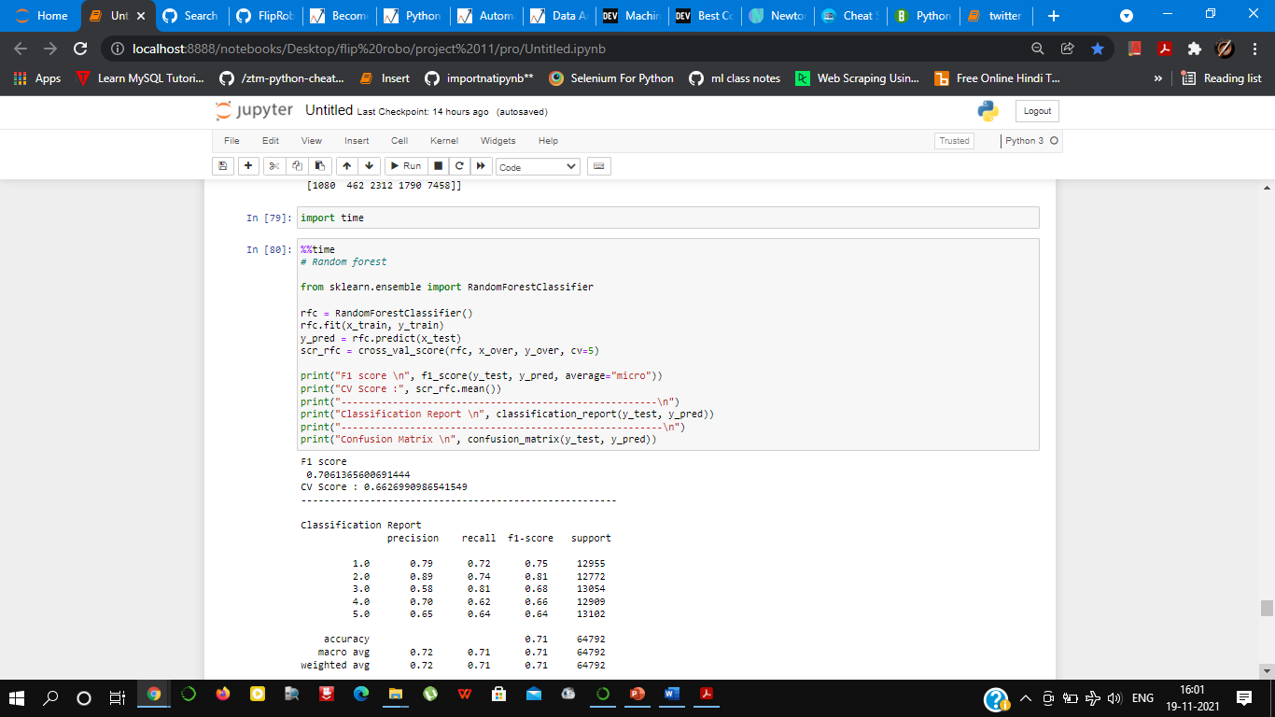

Slide 19
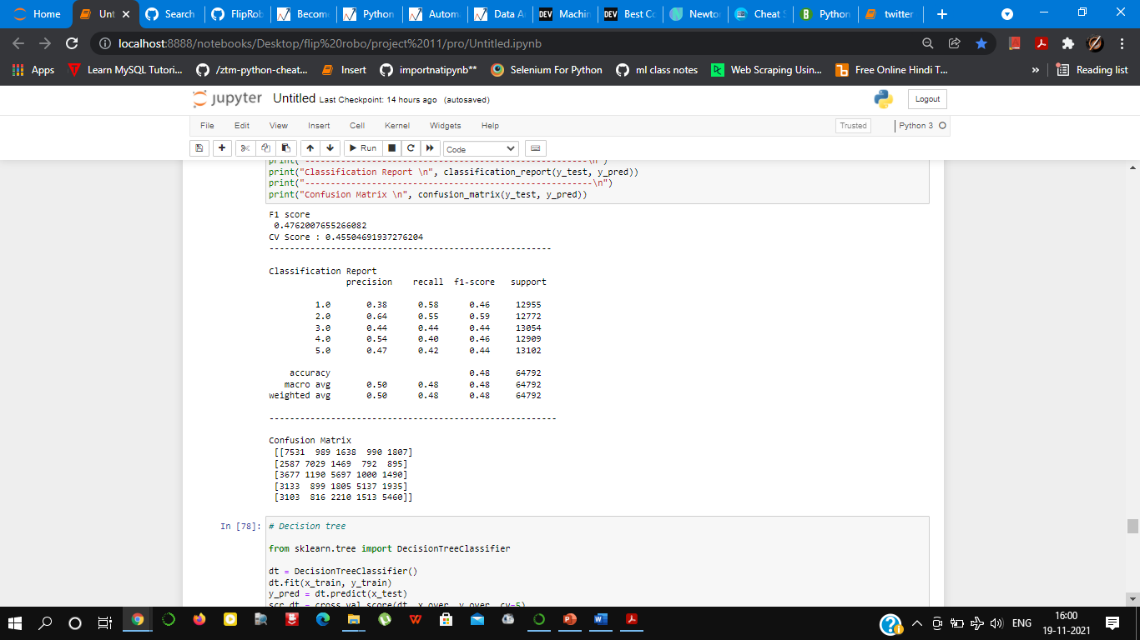
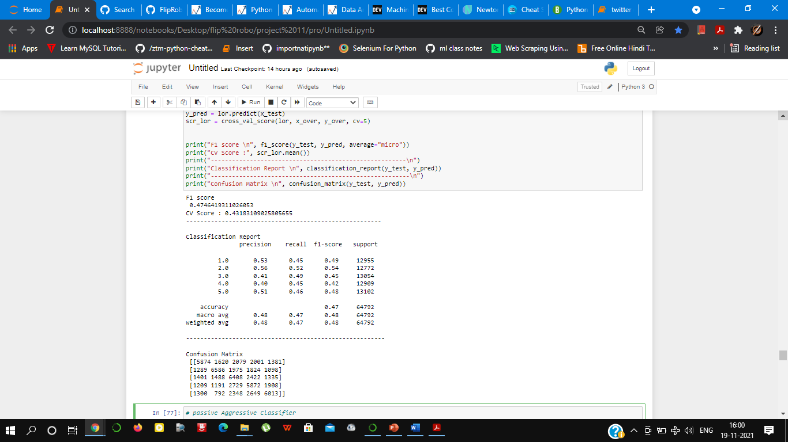
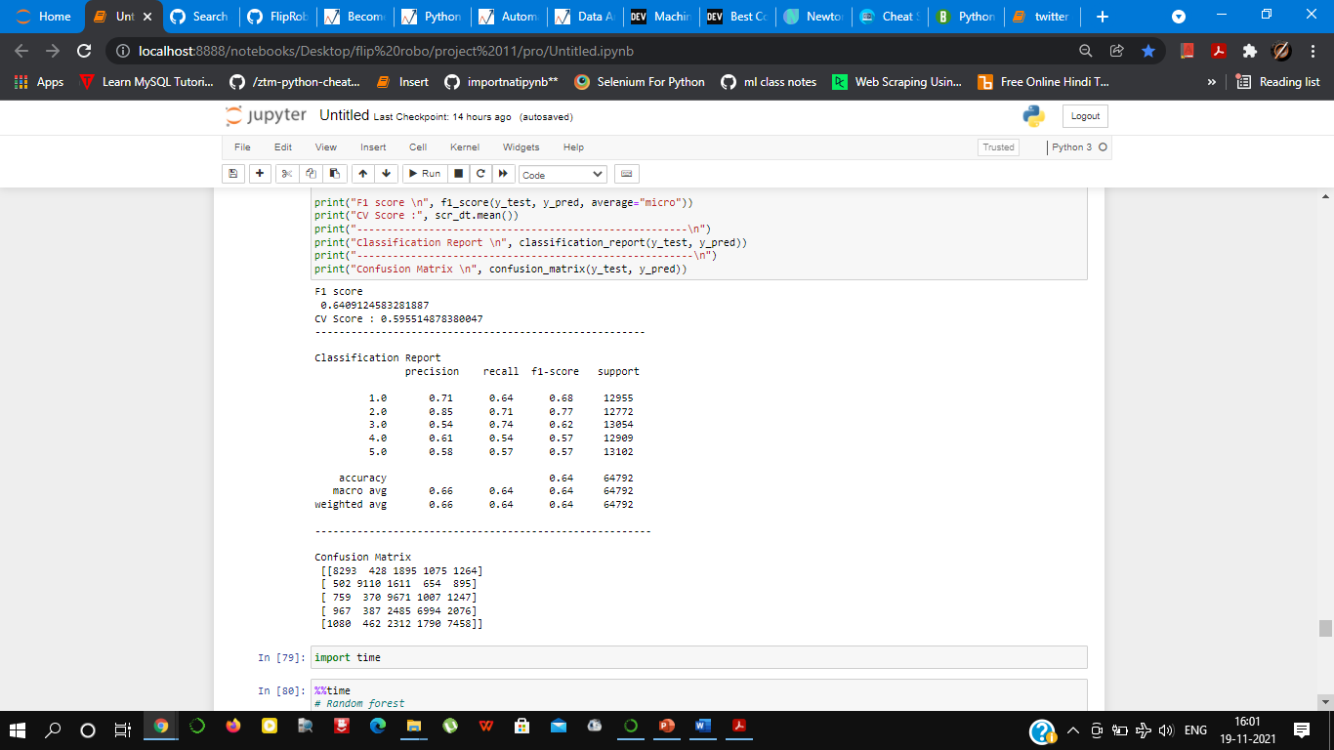
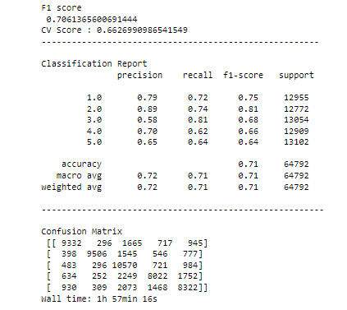
Cross validation

Slide 20
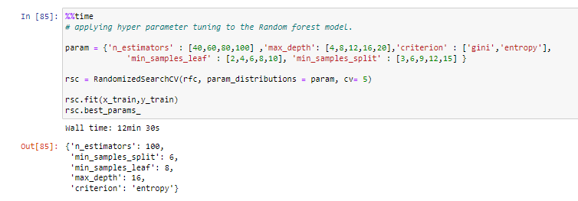
Hyper-parameter tuning.

Slide 21
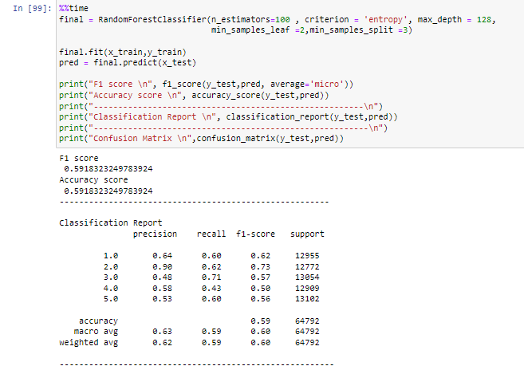
Prediction result after hyperparameter tuning.

Slide 22
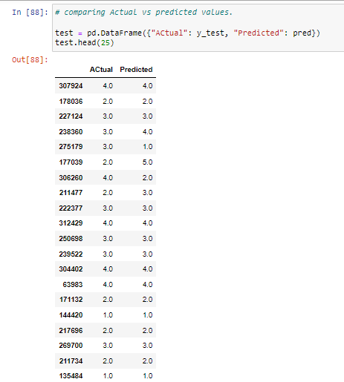
Comparison between Real value and Predicted value

Slide 23
Conclusion
The prediction from various models concludes that Random forest classifier is the best model for the prediction of the result. Which gives accuracy of 71% which in not the best but among all the models used it is the best model.
The model build after hyper-parametric tuning gives an accuracy for 59%, which means that hyper-parametric is not the solution here.

Slide 24
Thank You

